Slide 1
Adjectives
How to use it

Slide 2
Adjectives
I use adjectives to describe things, people, places...

Slide 3
Examples
She is beautiful.
She is a beautiful girl.

Slide 4
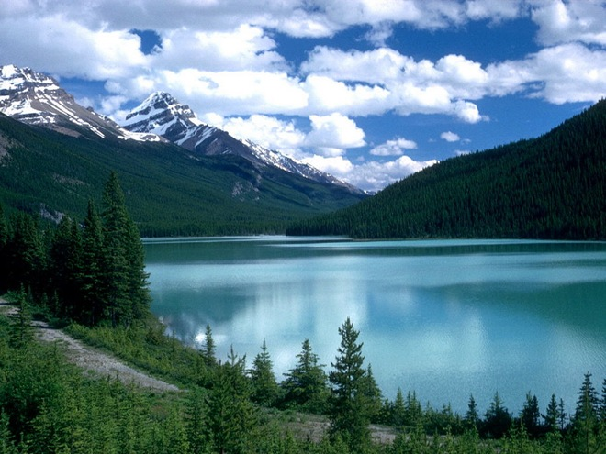
It is beautiful.
It is a beautiful picture.

Slide 5
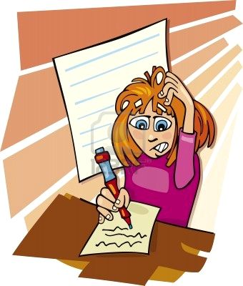
It is difficult.
It is a difficult test.

Slide 6
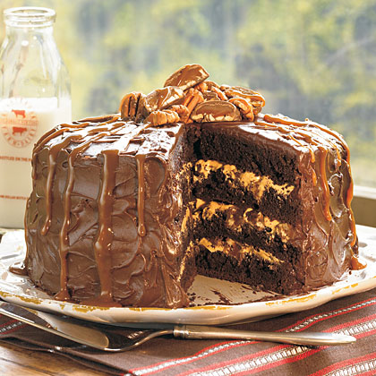
It is delicious.
It is a delicious cake.

Slide 7
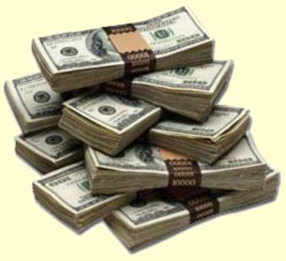
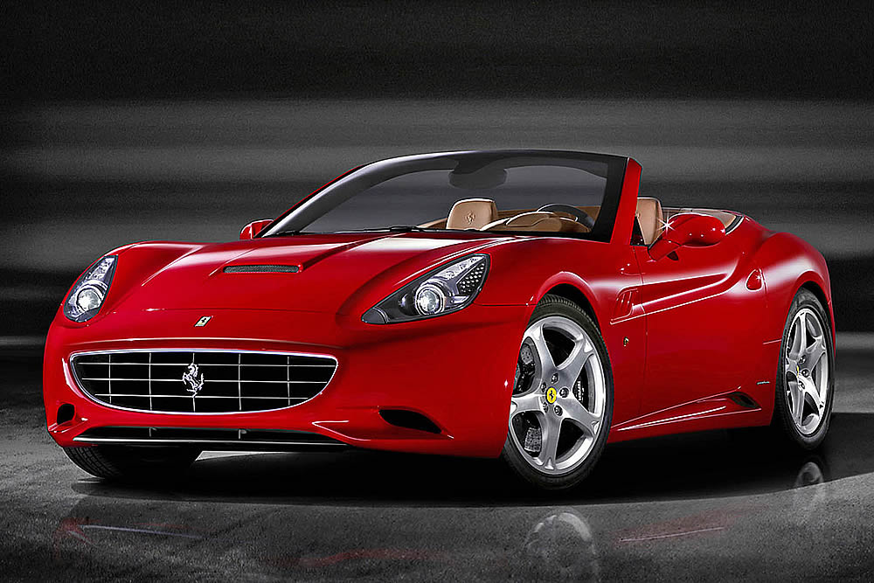
It is expensive.
It is an expensive car.

Slide 8
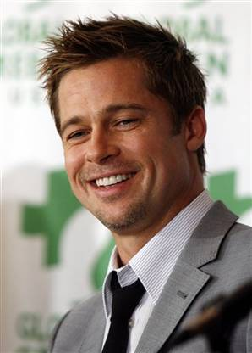
He is handsome.
He is a handsome man.

Slide 9
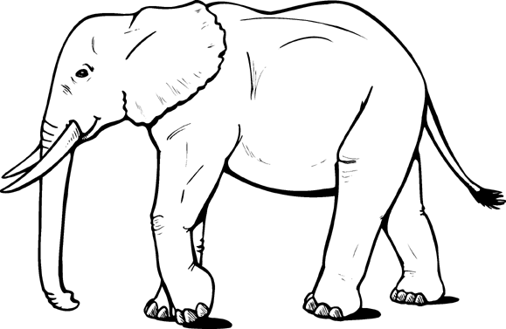
It is big.
It is a big elephant.

Slide 10
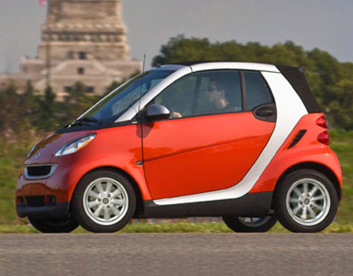
It is small.
It is a small car.

Slide 11
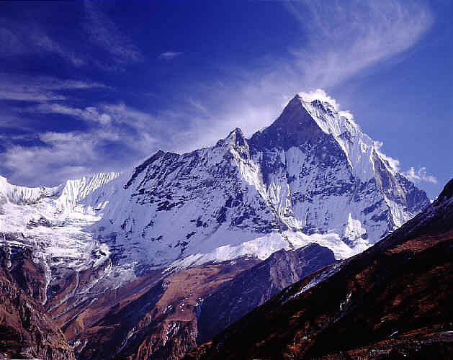
It is high.
It is a high mountain.

Slide 12
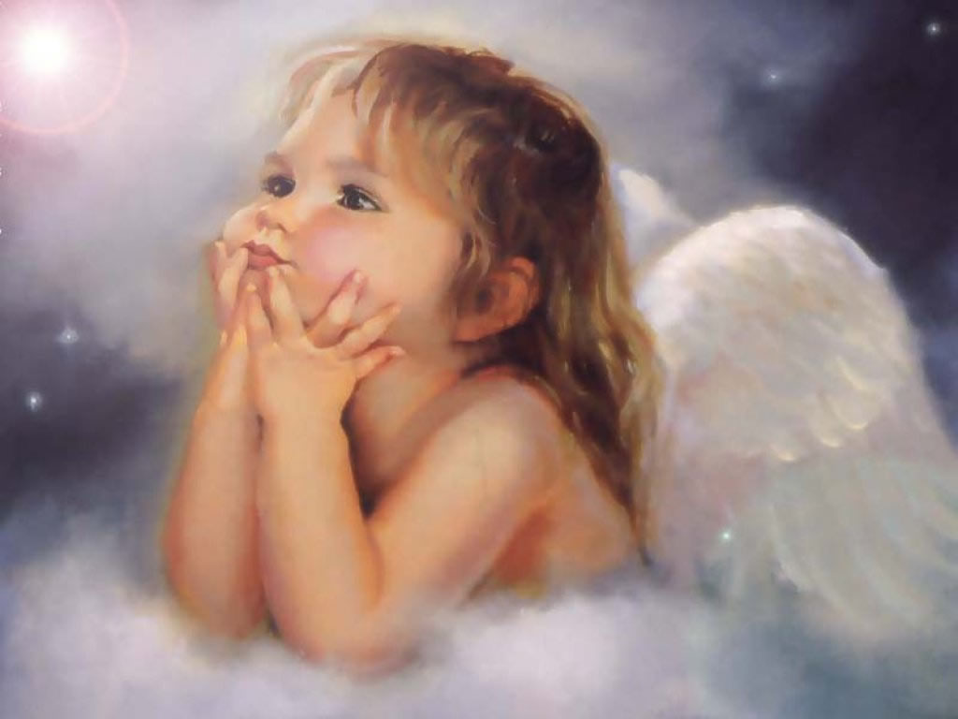
She is good.
She is a good angel.

Slide 13
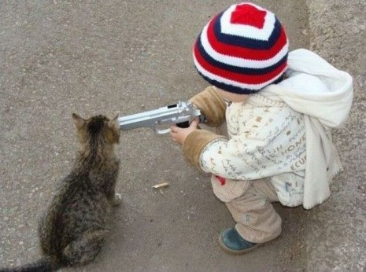
He is bad.
He is a bad boy.

Slide 14
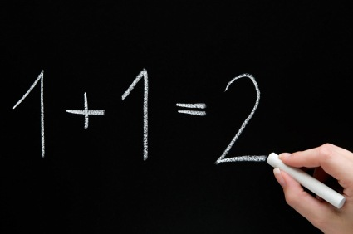
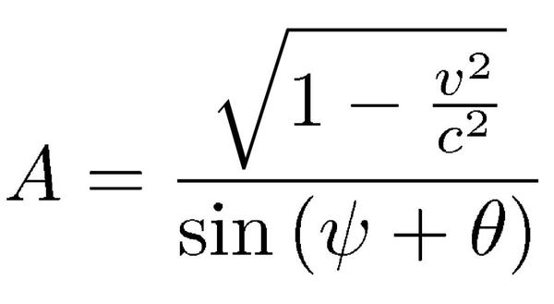
It is easy.
It is difficult.

Slide 15
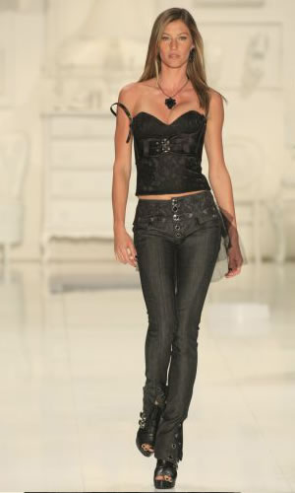
She is a famous model.
She is very tall.
She is slim.
She is not fat.

Slide 16
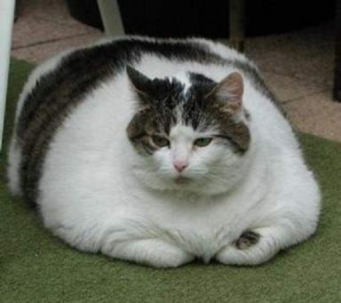
The cat is fat.

Slide 17
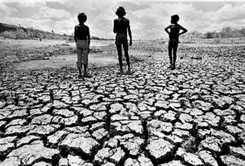
It is dry.

Slide 18
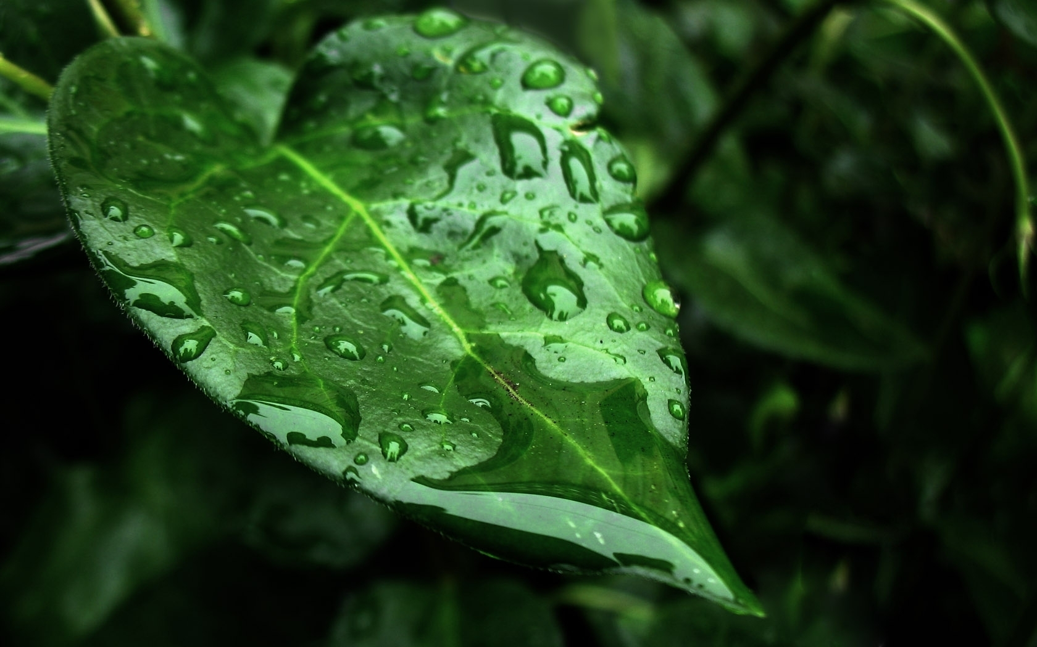
It is wet.

Slide 19
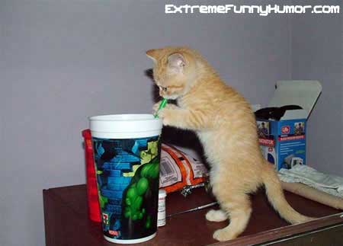
He is thirsty.

Slide 20
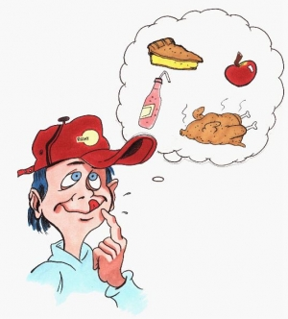
He is hungry.

Slide 21
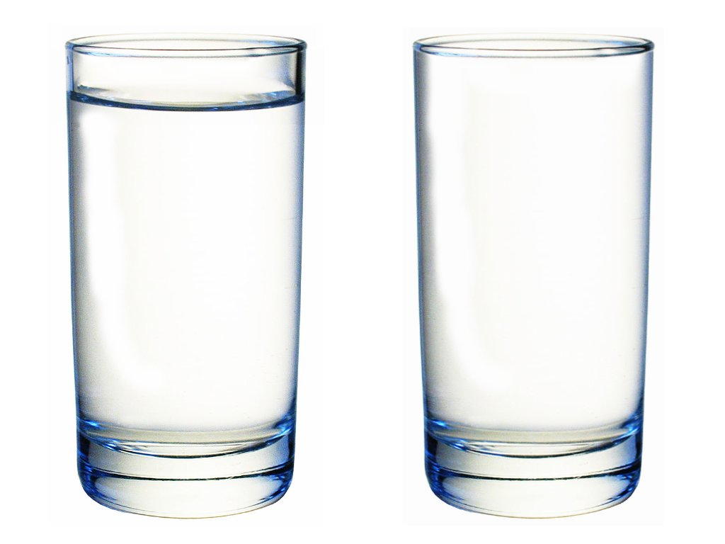
It is full.
It is empty.

Slide 22
He is short.
He is tall.

Slide 23
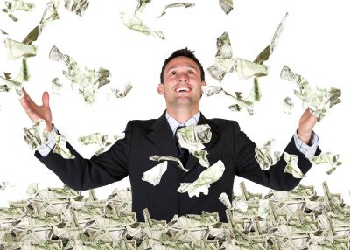
He is rich.

Slide 24
He is poor.

Slide 25
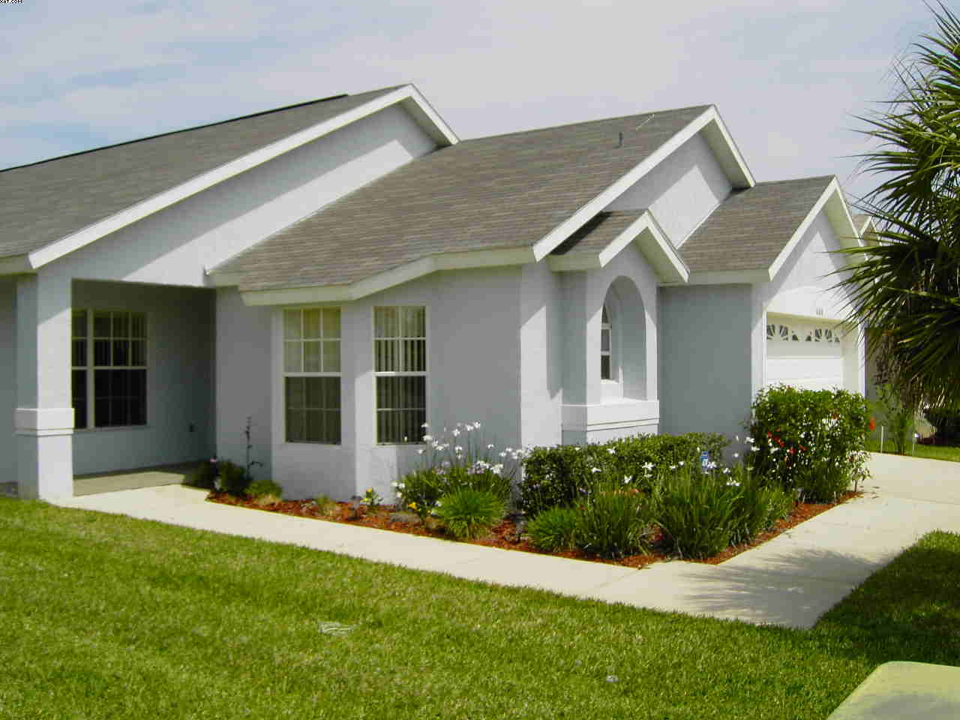
It is a new house.

Slide 26
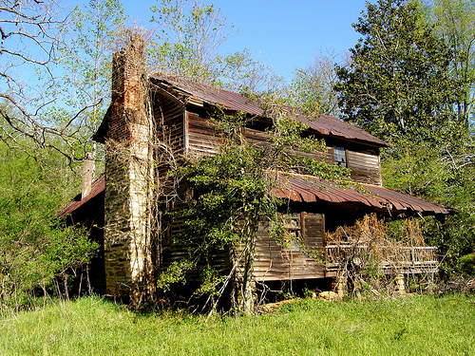
It is an old house.

Slide 27
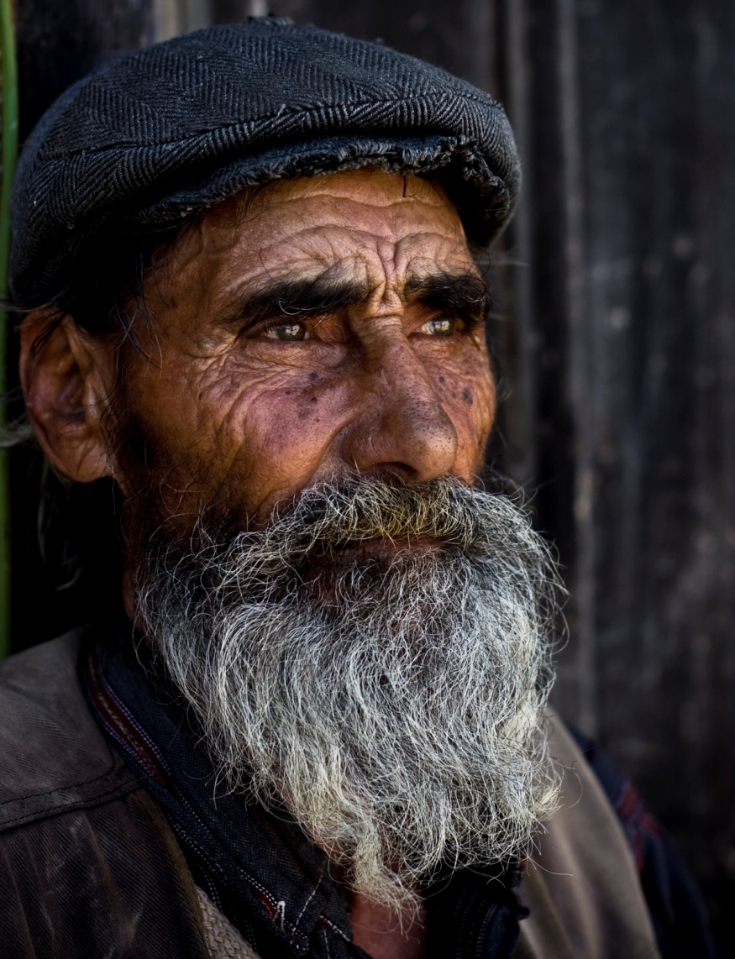
He is an old man.

Slide 28
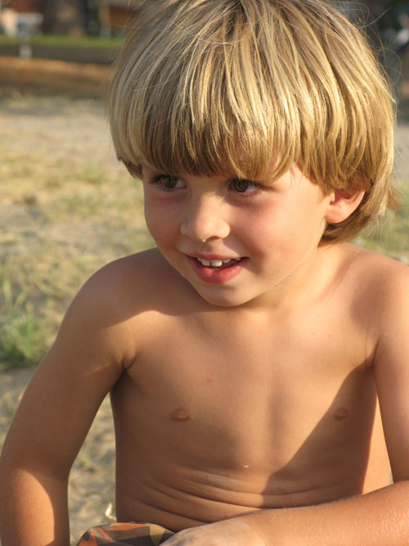
He is a young boy.

Slide 29
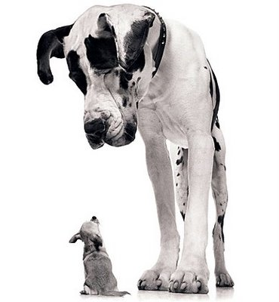

Slide 30
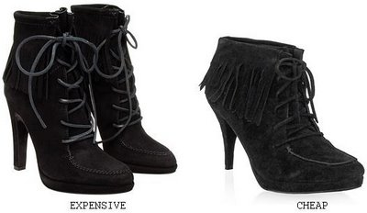

Slide 31
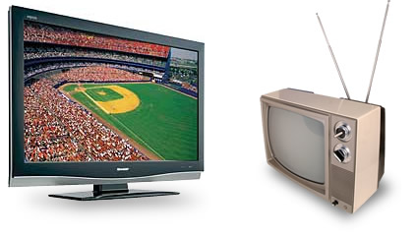

Slide 32
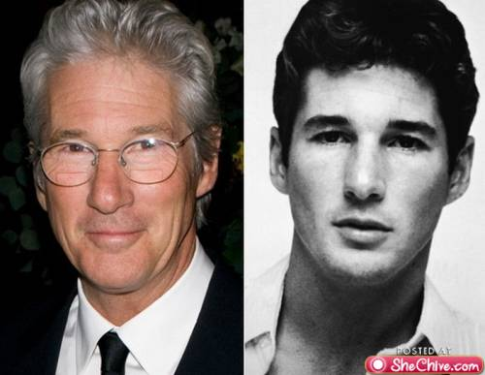

Slide 34
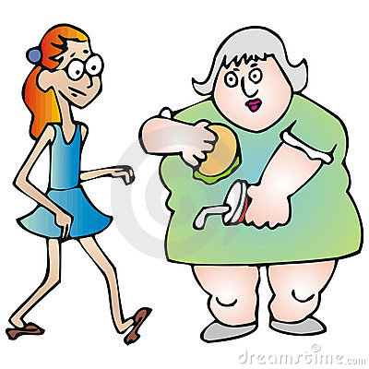

Slide 35
