Slide 1
COUNTRIES

Slide 2
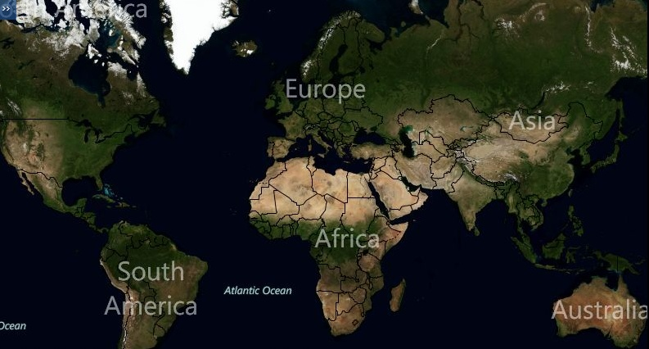

Slide 3
ARGENTINA

Slide 4
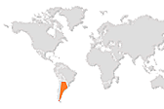

Slide 5
AUSTRALIA

Slide 6
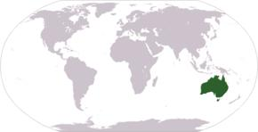

Slide 7
BRAZIL

Slide 8
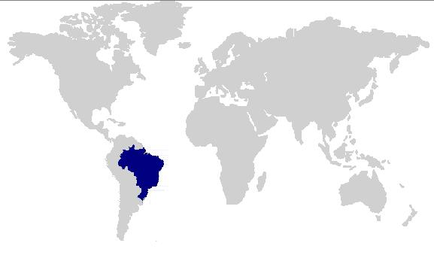

Slide 9
CANADA

Slide 10
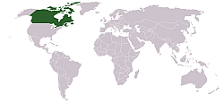

Slide 11
THE UNITED STATES

Slide 12
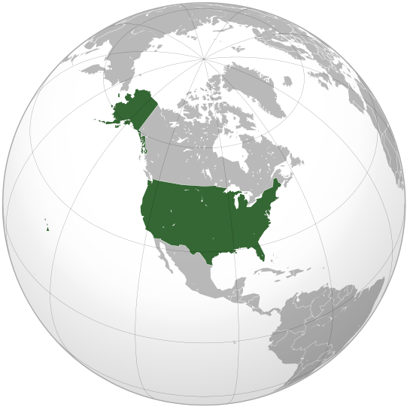

Slide 13
JAPAN

Slide 14
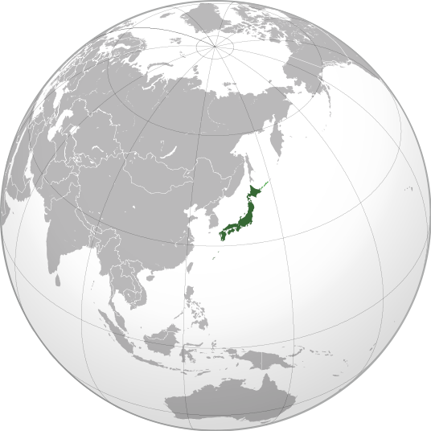

Slide 15
FRANCE

Slide 16
THE UNITED KINGDOM

Slide 17
SPAIN

Slide 18
GREECE

Slide 19
IRELAND

Slide 20
ITALY

Slide 21
PORTUGAL

Slide 22
POLAND

Slide 23
RUSSIA

Slide 24
TURKEY

Slide 25
