Slide 1
Family

Slide 2
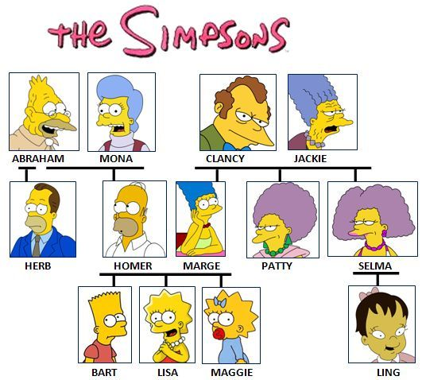
Family Tree

Slide 3
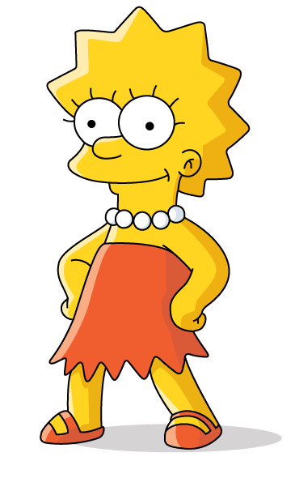
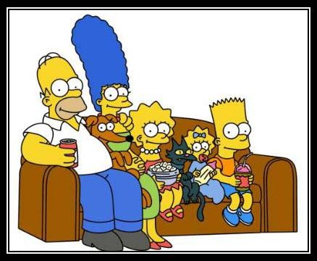
This is my family.

Slide 4
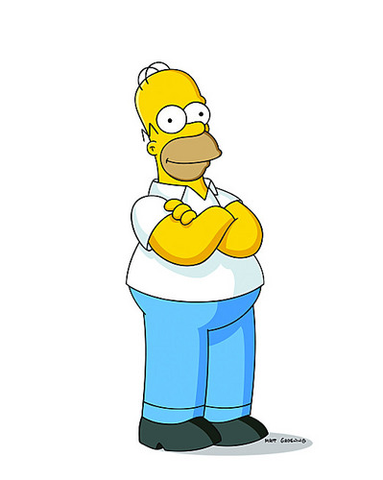
He is my father.

Slide 5
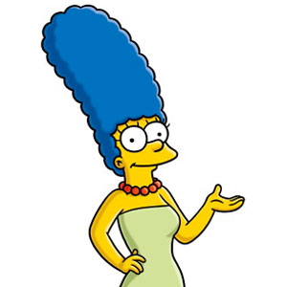
She is my mother.

Slide 6
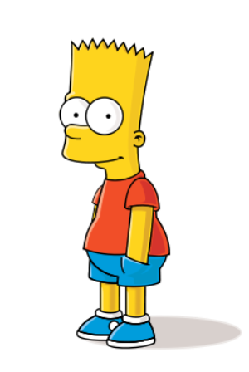
He is my brother.

Slide 7
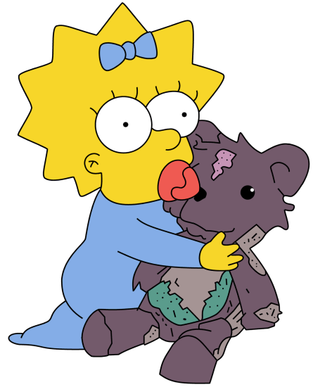
She is my sister.

Slide 8
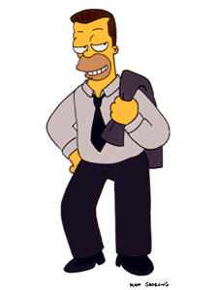
He is my uncle Herb.

Slide 9
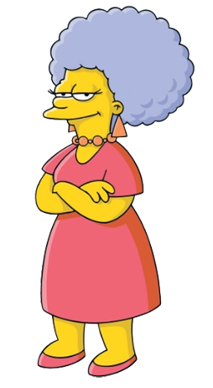
She is my aunt Patty.

Slide 10
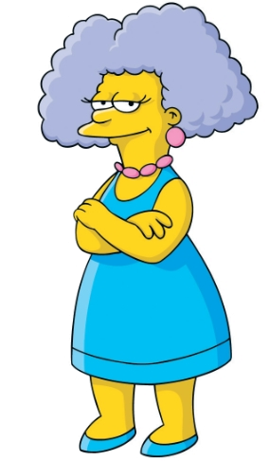
She is my aunt Selma.

Slide 11
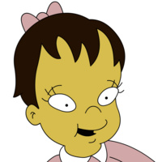
She is my cousin Ling.

Slide 12
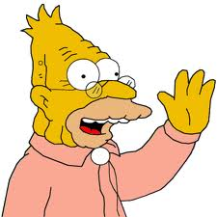
He is my grandfather .

Slide 13
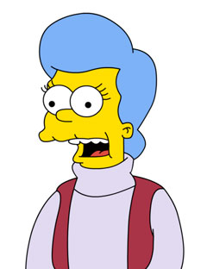
She is my grandmother.

Slide 14
He is my grandfather .

Slide 15
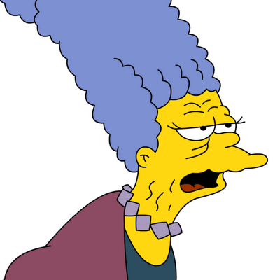
She is my grandmother.

Slide 16
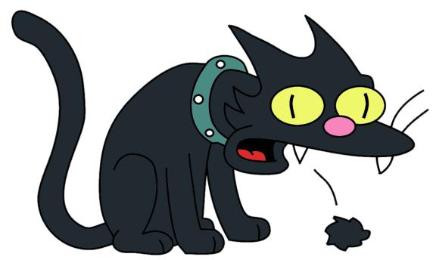
He is my cat Snowball.

Slide 17
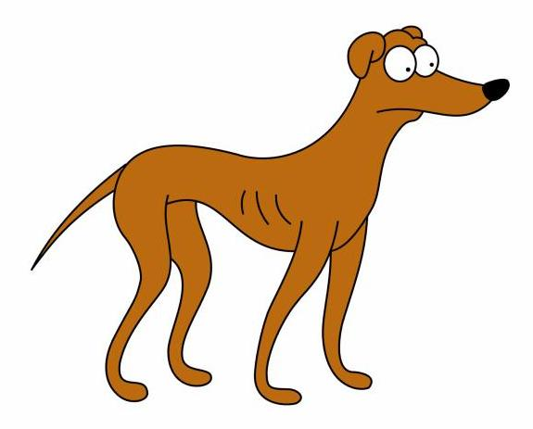
He is my dog.

Slide 18
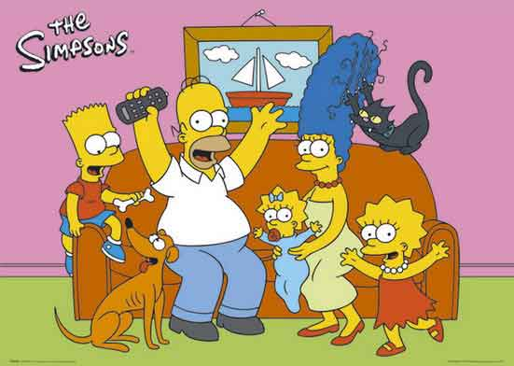

Slide 19
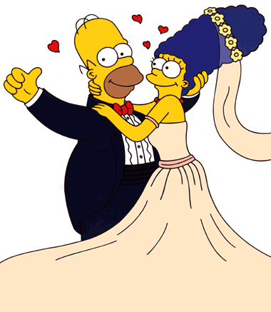
Homer is Marge’s husband.

Slide 20
Marge is Homer’s wife.

Slide 21
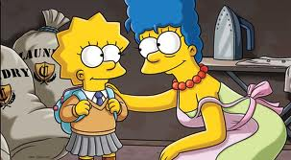
Lisa is Marge’s daughter.

Slide 22
Marge is Lisa’s mother.

Slide 23
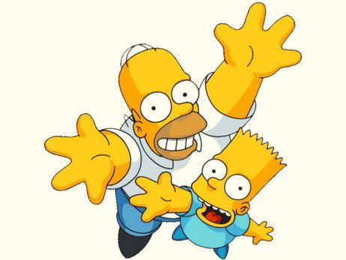
Homer is Bart’s father.

Slide 24
Bart is Homer’s son.

Slide 25
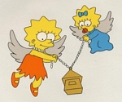
Lisa is Maggie’s sister.

Slide 26
Maggie is Lisa’s sister.

Slide 27
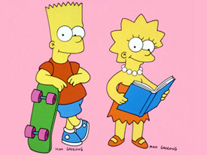
Lisa is Bart’s sister.

Slide 28
Bart is Lisa’s brother.

Slide 29
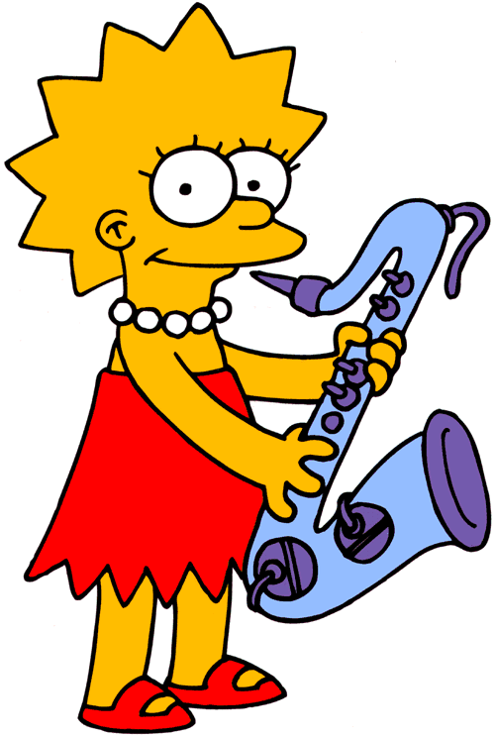
Lisa is Herb’s niece.

Slide 30
Herb is Lisa’s uncle.

Slide 31
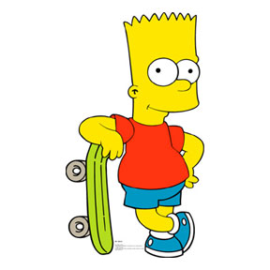
Bart is Herb’s nephew.

Slide 32
Herb is Bart’s uncle.

Slide 33
Lisa is Selma’s niece.

Slide 34
Selma is Lisa’s aunt.

Slide 35
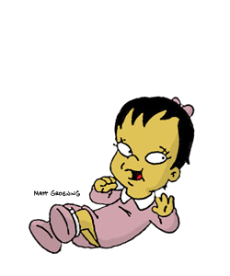
Lisa is Ling’s cousin.

Slide 36
Ling is Lisa’s cousin.

Slide 37
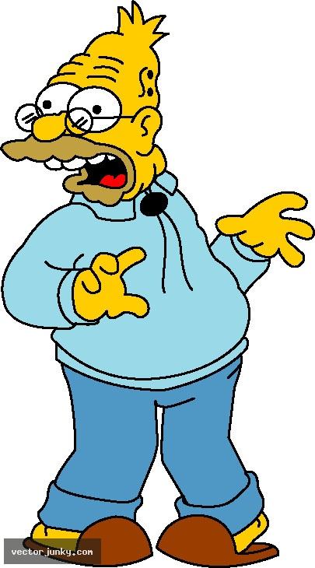
Abraham is Bart’s grandfather.

Slide 38
Bart is Abraham’s grandson.

Slide 39
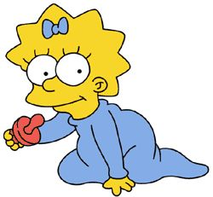
Mona is Maggie’s grandmother.

Slide 40
Maggie is Mona’s granddaughter.

Slide 41
Now you complete the sentences.

Slide 42
Homer is Marge’s _________.

Slide 43
Marge is Homer’s _____.

Slide 44
Lisa is Marge’s __________.

Slide 45
Marge is Lisa’s ________.

Slide 46
Homer is Bart’s ________.

Slide 47
Bart is Homer’s _______.

Slide 48
Lisa is Maggie’s ______.

Slide 49
Maggie is Lisa’s _______.

Slide 50
Lisa is Bart’s .

Slide 51
Bart is Lisa’s .

Slide 52
Lisa is Herb’s .

Slide 53
Herb is Lisa’s .

Slide 54
Bart is Herb’s .

Slide 55
Herb is Bart’s .

Slide 56
Lisa is Selma’s .

Slide 57
Selma is Lisa’s .

Slide 58
Lisa is Ling’s .

Slide 59
Ling is Lisa’s .

Slide 60
Abraham is Bart’s .

Slide 61
Bart is Abraham’s _________.

Slide 62
Mona is Maggie’s .

Slide 63
Maggie is Mona’s .

Slide 64
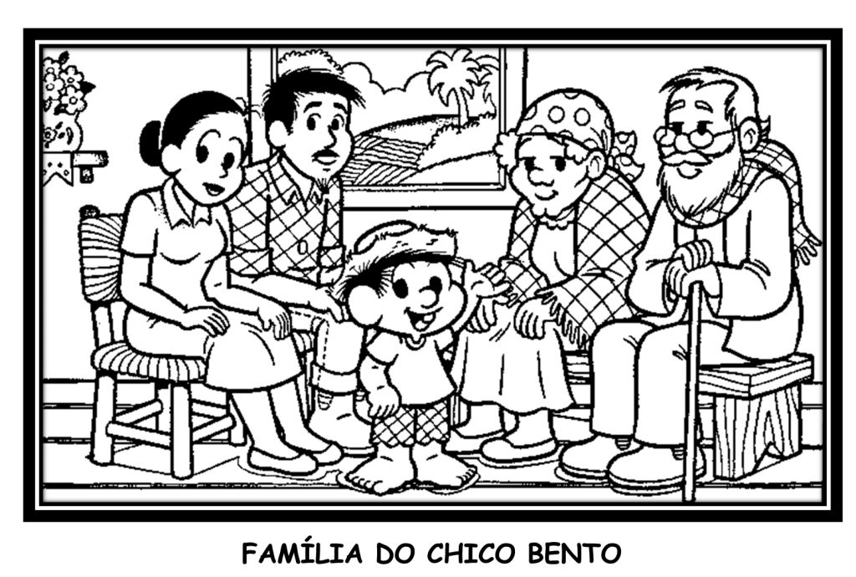
Chico Bento’s Family Tree
Tonico
Cotinha
Dita
Lau
Chico Bento
Who is who?

Slide 65
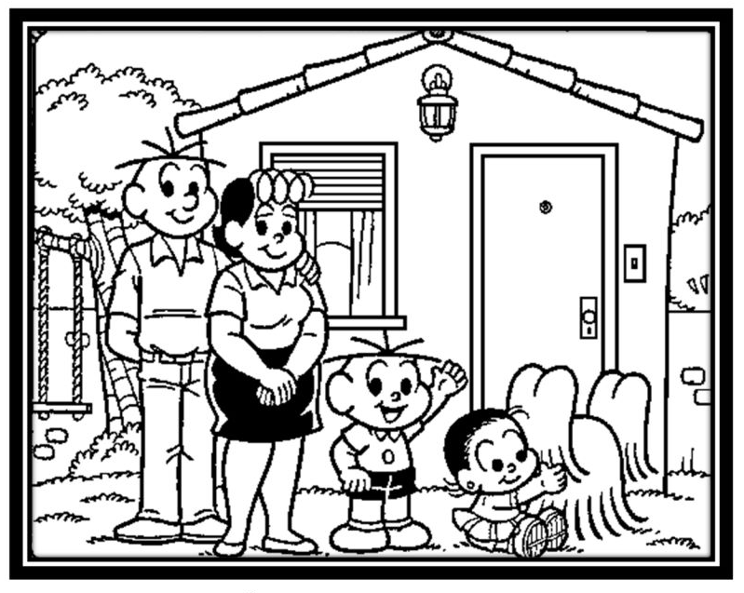
Jimmy Five’s Family Tree
Cebolácio
Cebola
Jimmy Five
Floquinho
Maria

Slide 66
Thanks for watching!
Adriana Pires de Sousa

