Slide 1
Family members

Slide 2
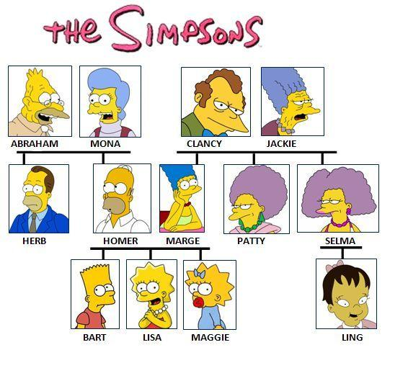

Slide 3
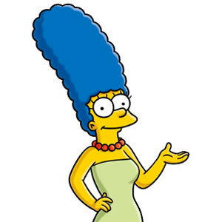
Homer is Marge’s...

Slide 4
husband.

Slide 5
Marge is Homer’s...

Slide 6
wife.

Slide 7
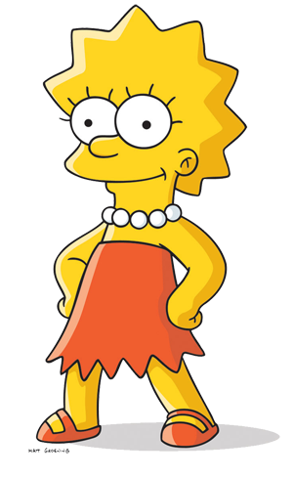
Homer is Lisa’s...

Slide 8
father.

Slide 9
Marge is Lisa’s...

Slide 10
mother.

Slide 11
Homer and Marge are Lisa’s...

Slide 12
parents.

Slide 13
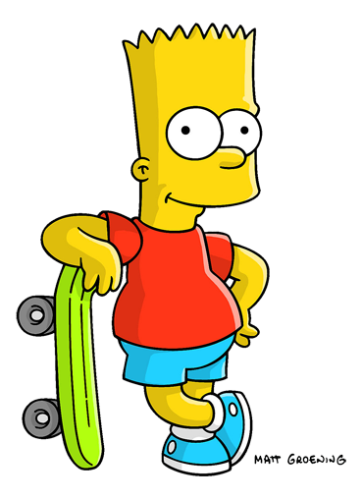
Bart is Marge’s...

Slide 14
son.

Slide 15
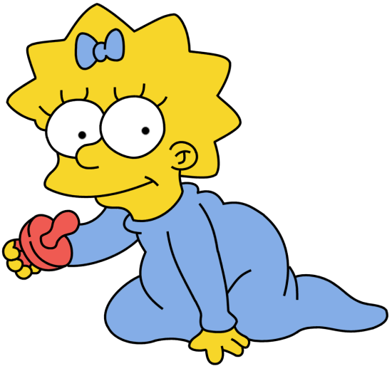
Maggie is Homer’s...

Slide 16
daughter.

Slide 17
Lisa, Bart and Maggie are Marge’s...

Slide 18
kids / children.

Slide 19
Bart is Lisa’s...

Slide 20
brother.

Slide 21
Maggie is Bart’s...

Slide 22
sister.

Slide 23
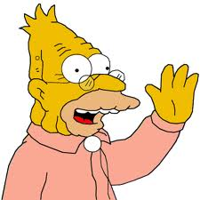
Abraham is Bart’s...

Slide 24
grandfather / grandpa.

Slide 25
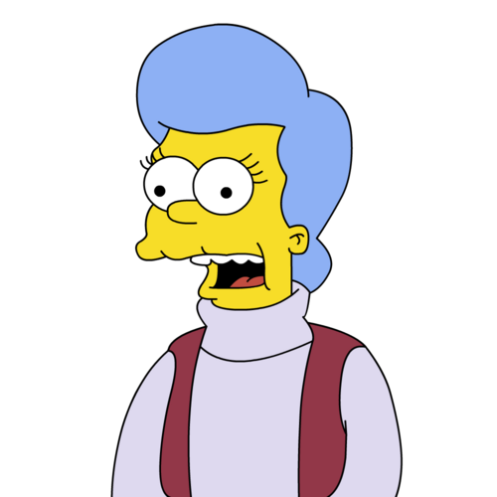
Mona is Bart’s ...

Slide 26
grandmother / grandma.

Slide 27
Abraham and Mona are Lisa’s...

Slide 28
grandparents.

Slide 29
Lisa is Mona’s...

Slide 30
granddaughter.

Slide 31
Bart is Mona’s...

Slide 32
grandson.

Slide 33
Lisa, Bart and Maggie are Mona’s...

Slide 34
grandchildren.

Slide 35
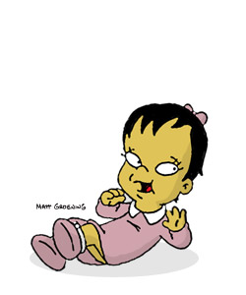
Ling is Maggie’s...

Slide 36
cousin.

Slide 37
Herb is Lisa’s...

Slide 38
uncle.

Slide 39
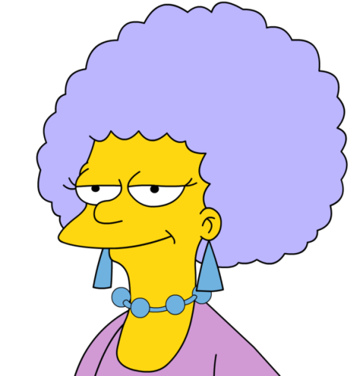
Selma is Lisa’s...

Slide 40
aunt.

Slide 41
Maggie is Selma’s...

Slide 42
niece.

Slide 43
Bart is Selma’s...

Slide 44
nephew.

