Slide 1
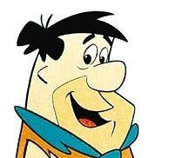
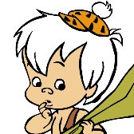
My Family Tree
Pearl Slaghooples
Wilma Fred Barney Betty
Pedrita Bam-Bam

Slide 2
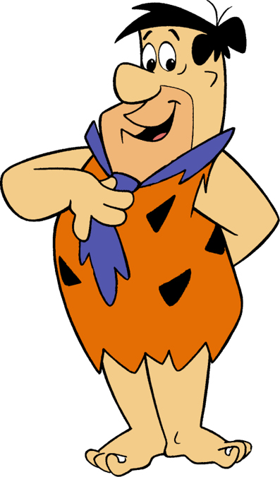
This is my family.

Slide 3
She's my wife Wilma.

Slide 4
She is my daughter Pedrita.

Slide 5
He's my dog Dino.

Slide 6
He's my brother Barney.

Slide 7
This is my sister-in-law Betty.

Slide 8
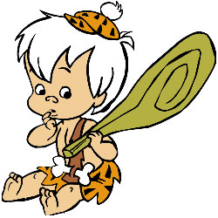
This is my nephew Bam-Bam.

Slide 9
This is my mother-in-law Pearl Slaghoople.

Slide 11
Fred is Wilma’s husband.

Slide 12
Wilma is Fred’s wife.

Slide 13
Pedrita is Wilma’s daughter.

Slide 14
Wilma is Pedrita’s mother.

Slide 15
Fred is Pedrita’s father.

Slide 16
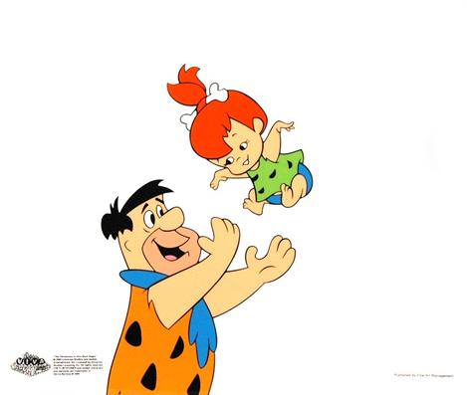
Pedrita is Fred’s daughter.

Slide 17
Fred is Barney’s brother.

Slide 18
Barney is Fred’s brother.

Slide 19
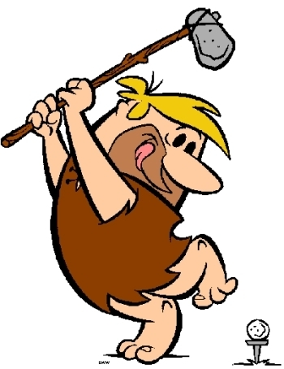
Pedrita is Barney’s niece.

Slide 20
Barney is Pedrita’s uncle.

Slide 21
Pedrita is Betty’s niece.

Slide 22
Betty is Pedrita’s aunt.

Slide 23
Pearl Slaghoople is Pedrita’s grandmother.

Slide 24
Petrita is Pearl Slaghoople’s granddaughter.

Slide 25
Wilma is Betty’s sister-in-law and they are best friends.

Slide 26
Barney and Betty are married.

Slide 27
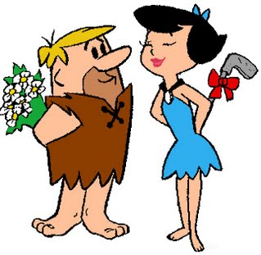
Betty and Barney have a son named Bam-Bam.

Slide 28
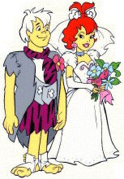
Pedrita and Bam-Bam are in love, They will get married soon.

Slide 29
Fred and his dog Dino.

Slide 30
The End

