Slide 1
Question Time
Basic Questions

Slide 2
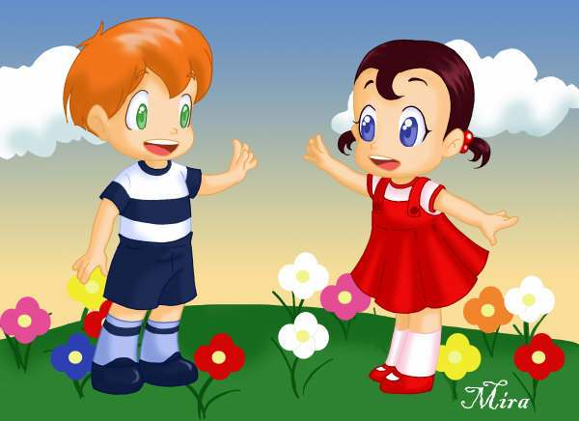
What’s your name?
My name is _____________

Slide 3
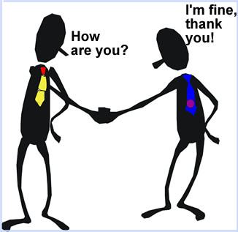
How are you?
I am fine.
I am ok.
I am so-so.
I am bad.

Slide 4
Where are you from?
I am from _______.

Slide 5
How old are you?
I am ______ years old.

Slide 6
What is your phone number?
My phone number is ______.

Slide 7
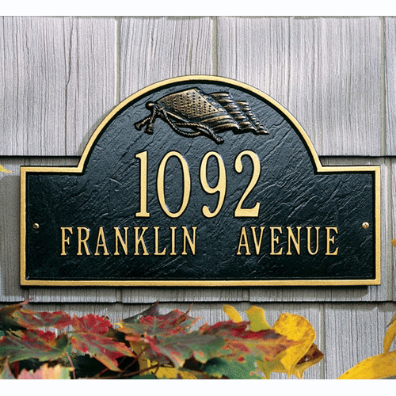
What is your home address?
My home address is QNM 07 street H house 24. Ceilândia Sul.

Slide 8
What is your e-mail address?
My e-mail address is roger@hotmail.com

Slide 9
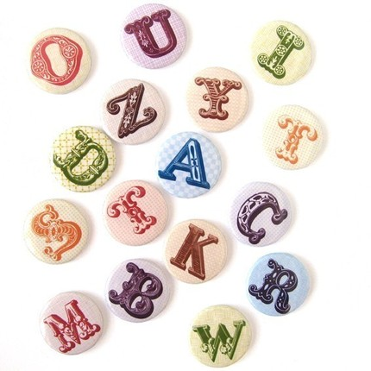
How do you spell your first name?
It is R-O-G-E-R. Roger

Slide 10
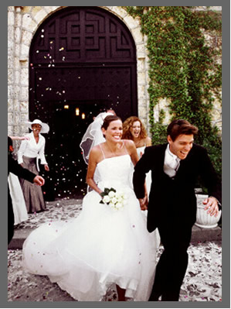
Are you married?
Yes, I am.
No, I am not.

Slide 11
What is her name?
Her name is Madonna.

Slide 12
How old is she?
She is 54 years old.

Slide 13
Where is she from?
She is from the
United States.

Slide 14
What does she do?
She is a singer.

Slide 15
Is she married?
No, she isn’t.

Slide 16
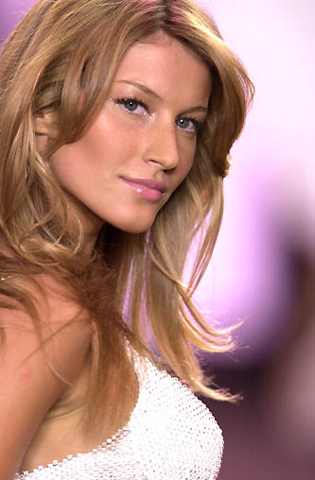
What is her name?
Her name is Gisele Bündchen.

Slide 17
How do you spell her last name?
It is B-U-N-D - C-H-E-N. Bundchen

Slide 18
Where is she from?
She is from Brazil.

Slide 19
How old is she?
She is 32 years old.

Slide 20
What does she do?
She is a model.

Slide 21
What is your favorite color?
My favorite color is ____.

Slide 22
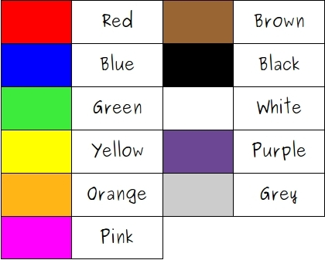

Slide 23
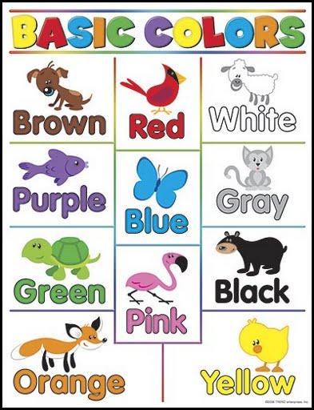

Slide 24
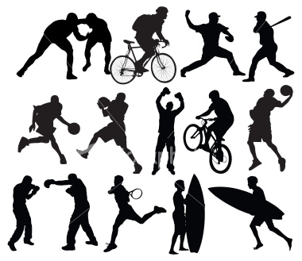
What is your favorite sport?
My favorite sport is ____.

Slide 25
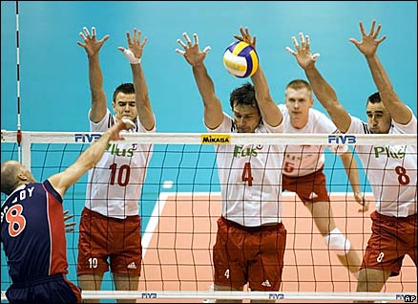
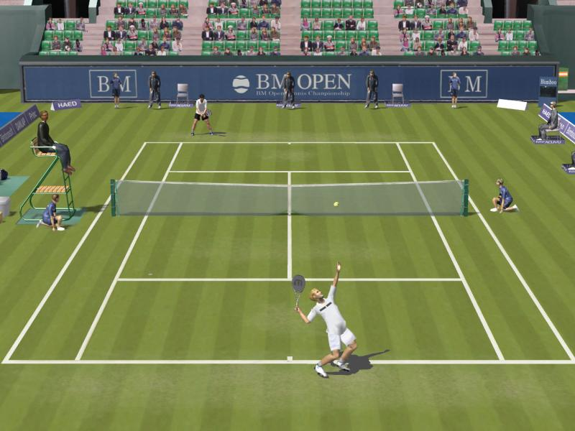
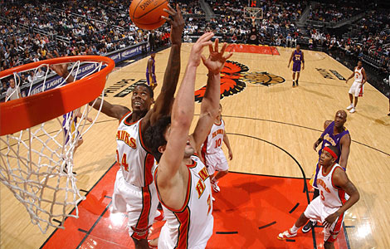
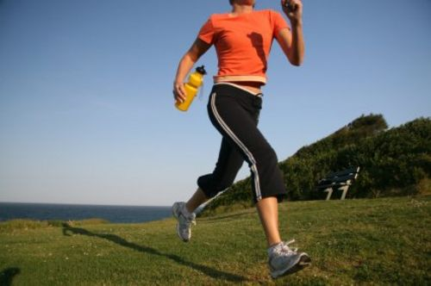
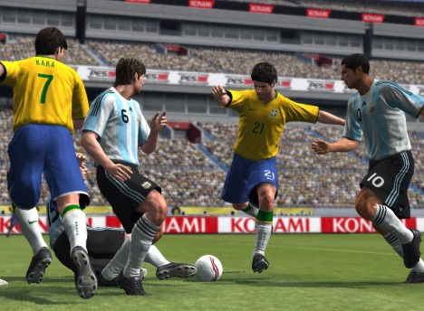
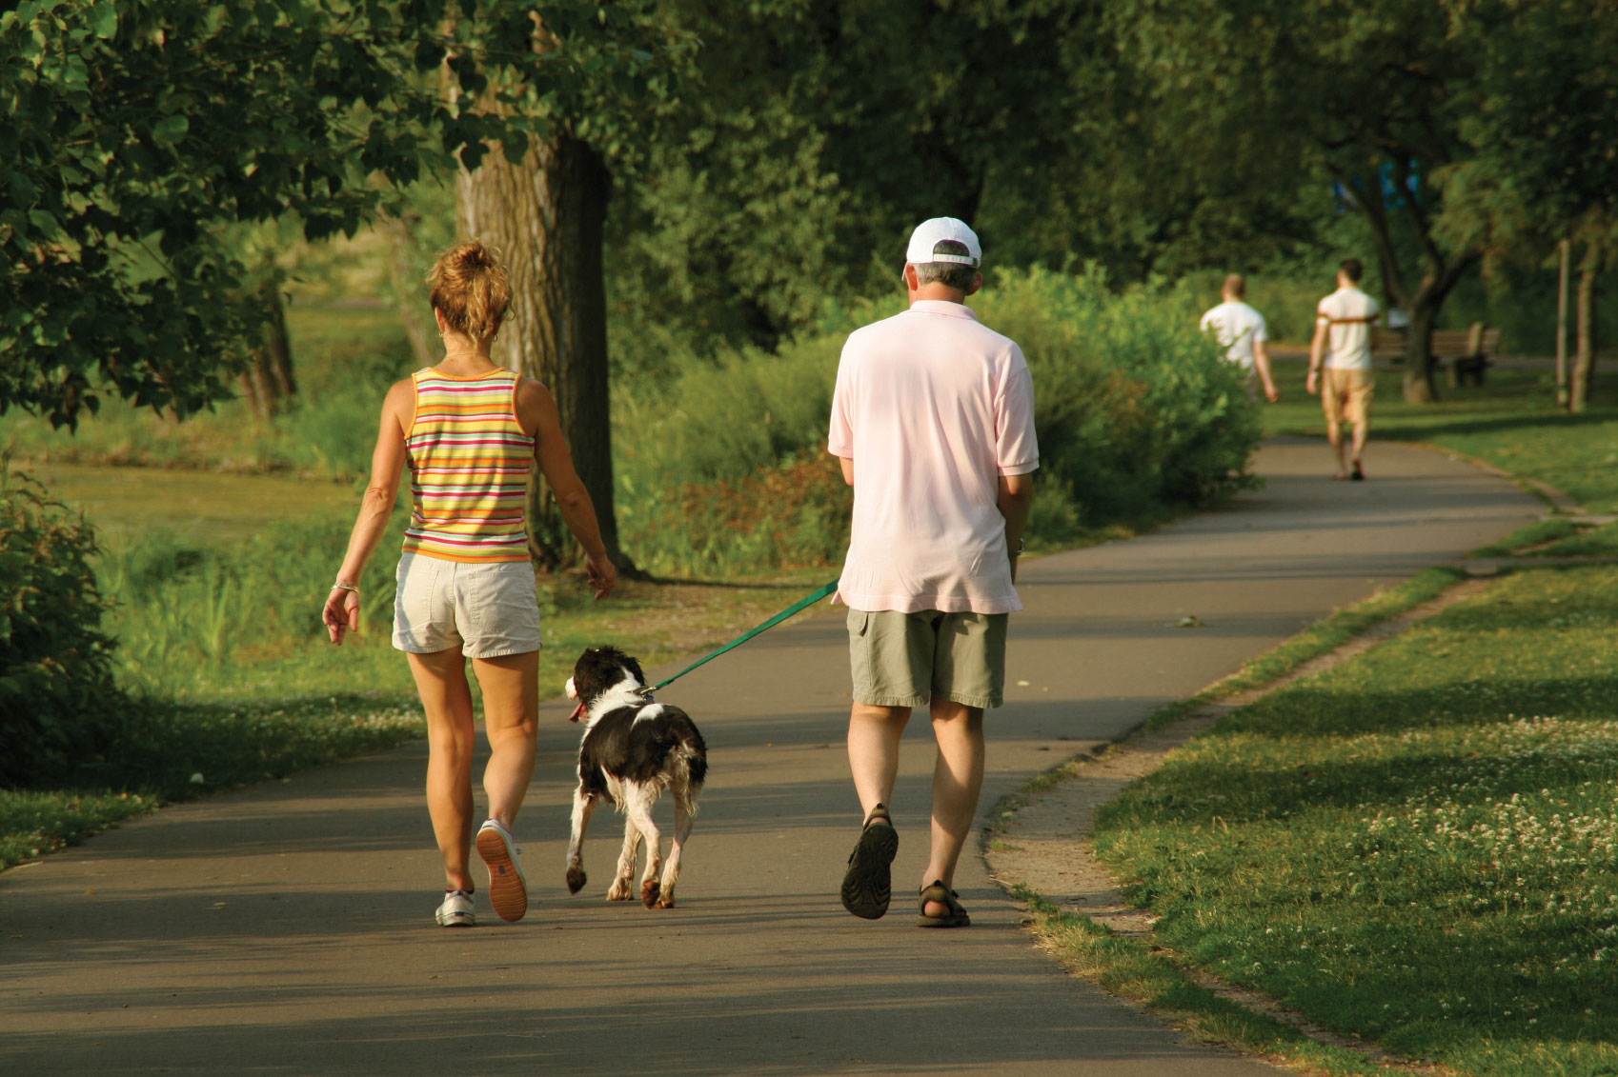
volleyball
tennis
basketball
running
soccer
walking

Slide 26
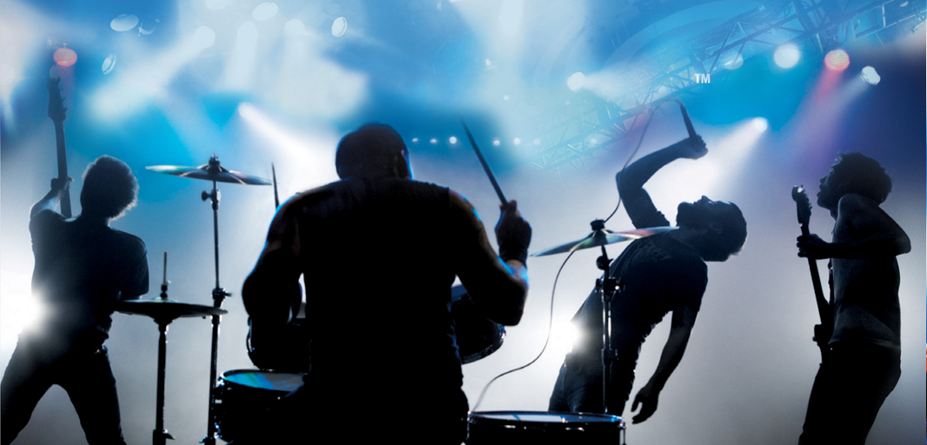
What is your favorite band?
My favorite band is ______.

Slide 27
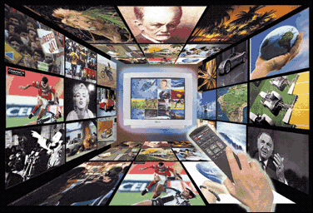
What is your favorite TV program?
My favorite TV program is ______.

Slide 28
Who is your favorite singer?
My favorite singer is _____.

Slide 29
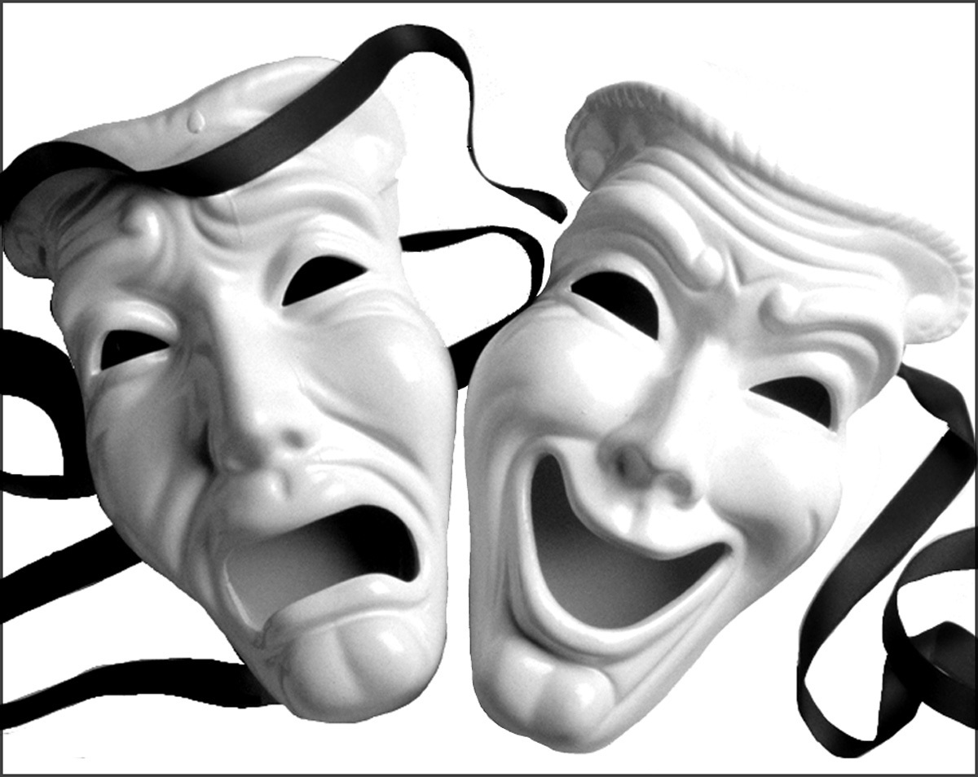
Who is your favorite actor/actress?
My favorite actor/actress is _________.

Slide 30
What is your job?
I am a student.

Slide 31
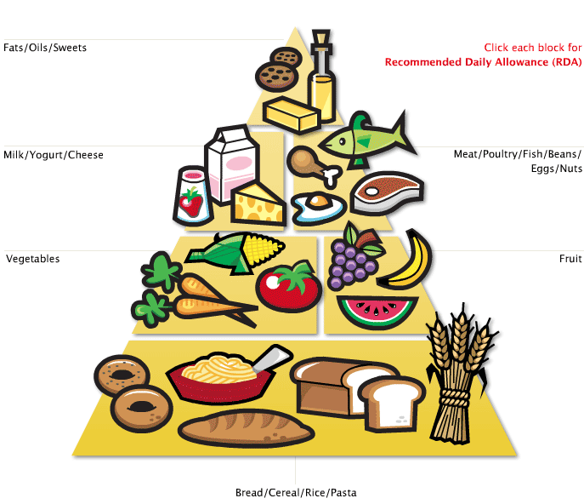
What is your favorite food?
My favorite food is _______.

Slide 32
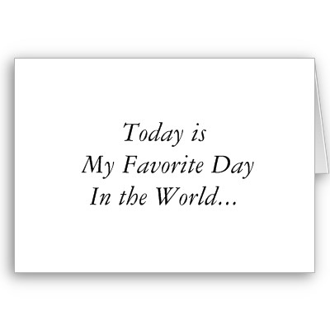
What is your favorite day of the week?
My favorite day is ________.

Slide 33
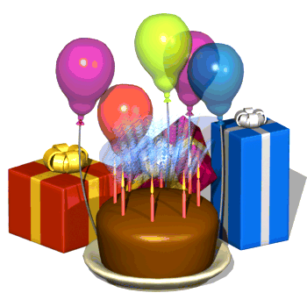
When is your birthday?
My birthday in on September 2nd.

Slide 34
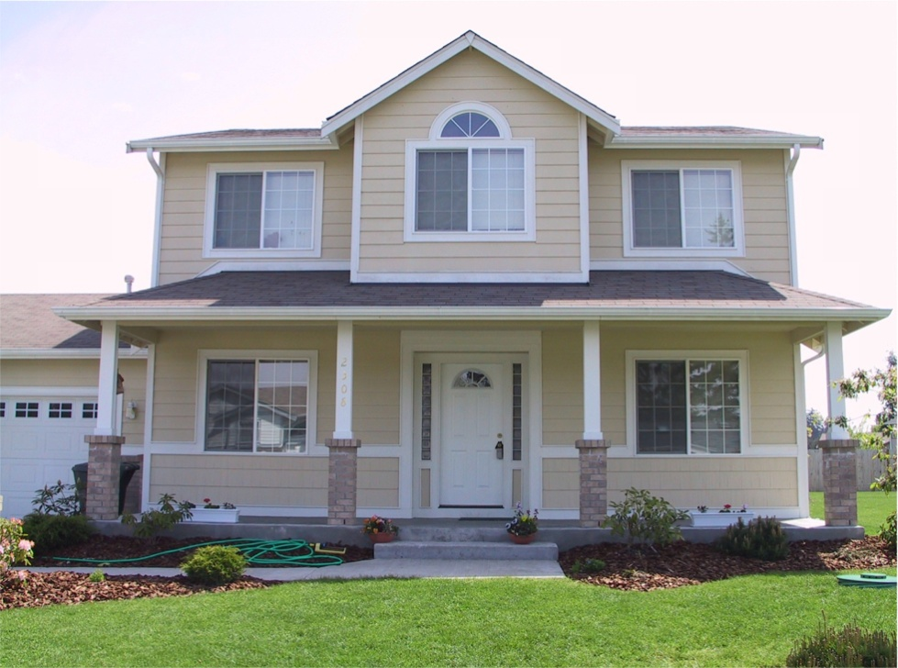
Where do you live?
I live in ______.

Slide 35
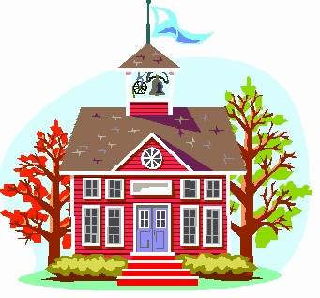
Where do you study?
I study in ________.

Slide 36
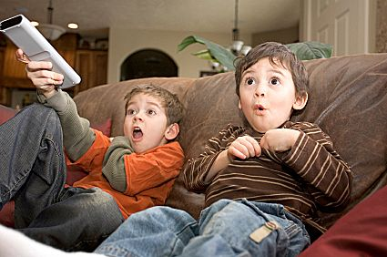
What do you do in your free time?
I watch television and I use the internet. Sometimes I sleep, too.

Slide 37
When do you study?
I study in the morning.
I study in the afternoon.
I study at night at Cilc.

Slide 38
What do you do?
I am a student.

Slide 39
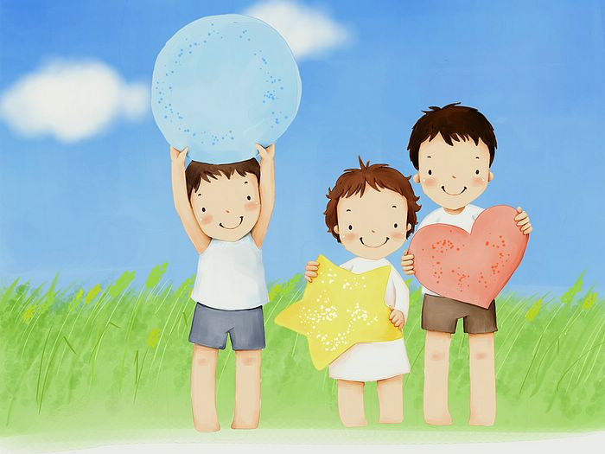
How many brothers and sisters do you have?
I have 2 brothers and 1 sister.

Slide 40
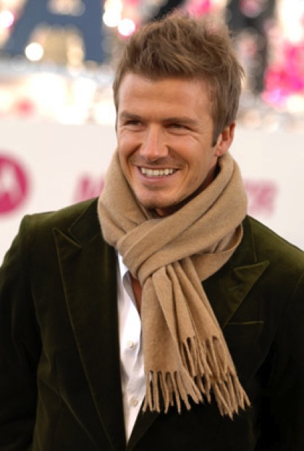
What is his name?
His name is David Beckham.
Where is he from?
He is from England.
How old is he?
He is 37 years old.

Slide 41
Is he married?
Yes, he is.
What does he do?
He is a soccer player.
What languages does he he he he speak?
He speaks English.

Slide 42
Where does he work?
He works in the stadium.
Does he have a family?
Yes, he does.
How many children does he have?
He has 4 children.

Slide 43
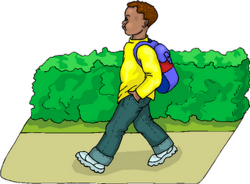
What do you do in the morning?
I go to school in the morning.

Slide 44
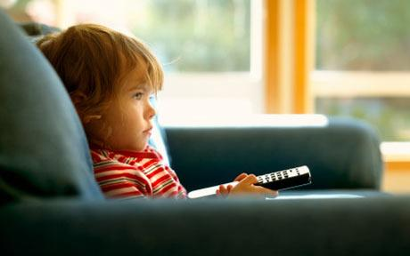
What does she do in the morning?
She watches TV in the morning.

Slide 45
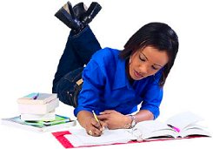
What do you do at night?
I do my homework at night.

Slide 46
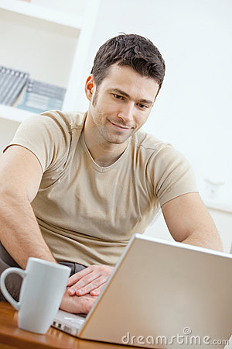
What does he do at night?
He uses the computer at night.

Slide 47
What do you like doing?
I love reading books.

Slide 48
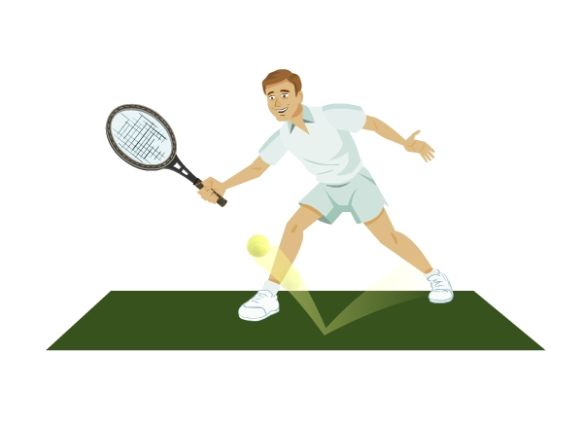
What does he like doing?
He likes playing tennis.

Slide 49
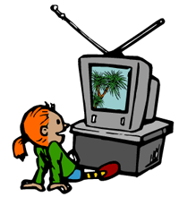
What does she like doing?
She likes watching television.

Slide 50
What does she like doing?
She likes swimming.

Slide 51
What does he love doing?
He loves sleeping.

Slide 52
What does she like doing?
She likes shopping.

Slide 53
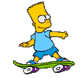
What does he like doing?
He likes skateboarding.

Slide 54
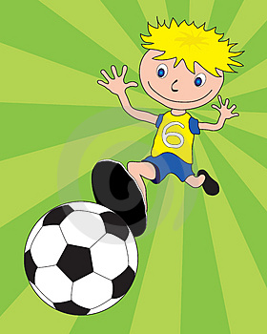
What does he love doing?
He loves playing soccer.

Slide 55
The End
Thanks for watching
Adriana Pires

