Slide 1
Routine Simple Present
Third Person

Slide 2
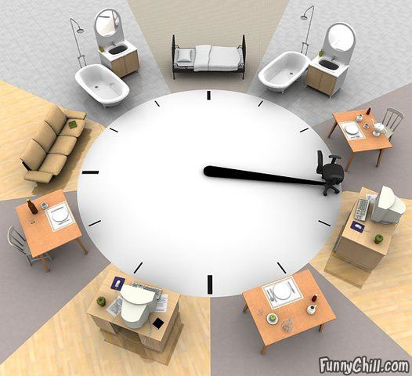
Wakes up
sleep
Take a bath
Take a bath
Have breakfast
rest
Have dinner
work
work
Have lunch

Slide 3
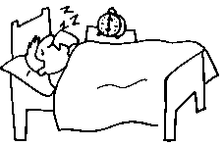
He wakes up at six o’clock.

Slide 4
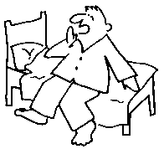
He gets up.

Slide 5
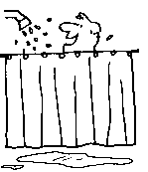
He takes a shower.

Slide 6
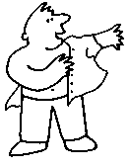
He gets dressed.

Slide 7
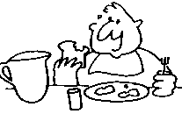
He has breakfast.

Slide 8
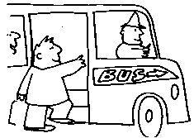
He leaves for work.

Slide 9
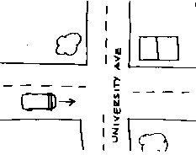
He goes to work by bus.

Slide 10
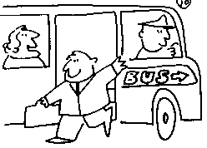
He gets off the bus.

Slide 11
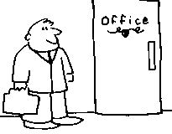
He arrives at work.

Slide 12
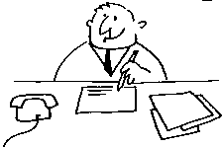
He starts work.

Slide 13
He reads the news.

Slide 14
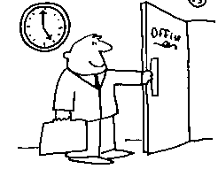
He leaves work.

Slide 15
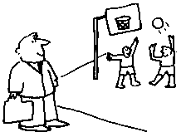
He walks home.

Slide 16
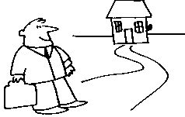
He arrives home.

Slide 17
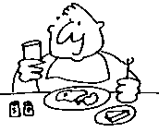
He eats dinner.

Slide 18
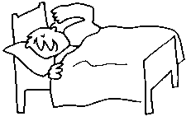
He goes to bed.

Slide 19
Is Peter’s Routine similar to yours?
He wakes up
He gets up
He takes a shower
He gets dressed
Has breakfast
He leaves for work
He goes to work by bus
He gets off the bus
He arrives at work
He starts work
He reads the news
He leaves work
He walks home
He arrives home
He eats dinner
He goes to bed

Slide 20
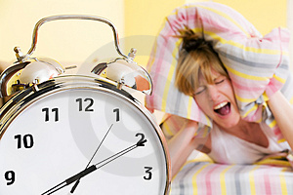
She wakes up.

Slide 21
She gets up.

Slide 22
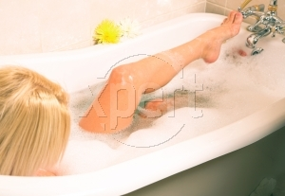
She has a bath.

Slide 23
She puts on contact lens.

Slide 24
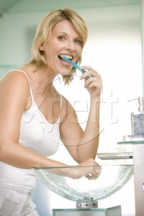
She brushes the teeth.

Slide 25
She puts on her make up.

Slide 26
She brushes the hair.

Slide 27
She arrives at work.

Slide 28
She works.

Slide 29
She goes shopping.

Slide 30
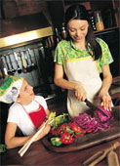
She cooks dinner.

Slide 31
She flosses the teeth.

Slide 32
She does the dishes.

Slide 33
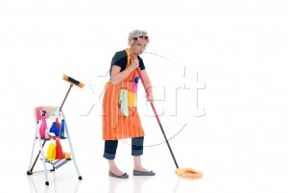
She cleans the house.

Slide 34
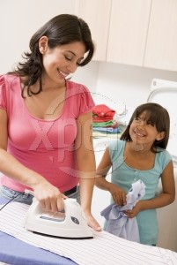
She irons clothes.

Slide 35
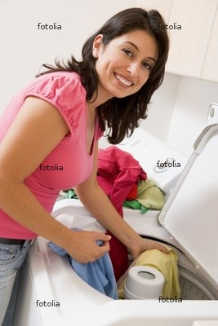
She does the laundry.

Slide 36
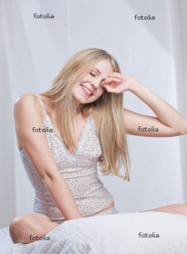
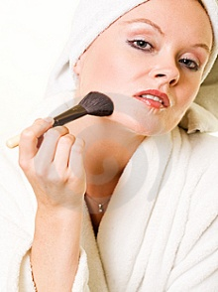
Mary’s Daily Routine
MORNING
She
wakes up
Gets up
Has a bath
Puts on
Contact lens
Brushes
the teeth
Puts on her
make up
AFTERNOON
Brushes the hair
Arrives at work
Works
Goes shopping
Cooks dinner
EVENING
Flosses the teeth
Does the dishes
Cleans the house
Irons clothes
Does the laundry

Slide 37
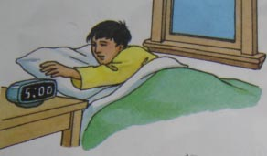
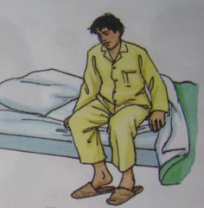
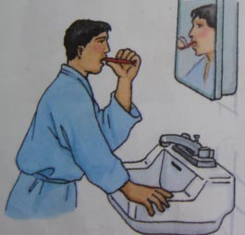
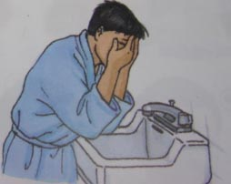
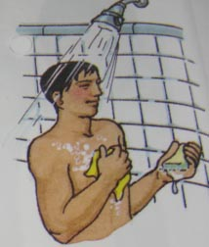
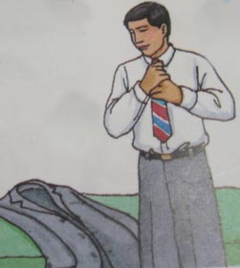
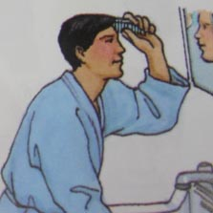
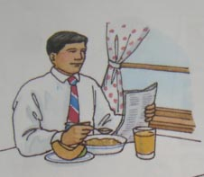
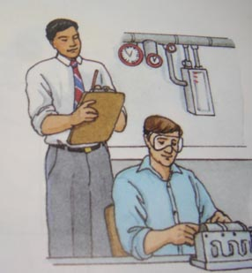
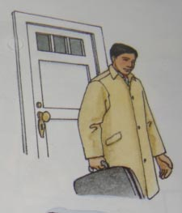
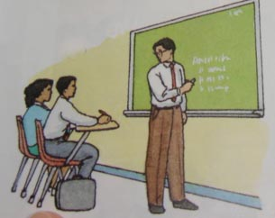
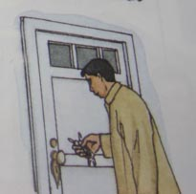
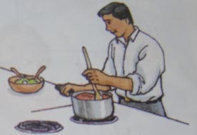
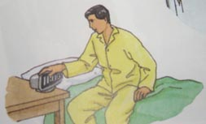
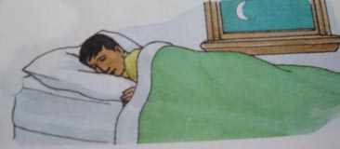
Joe’s Daily Routine
He wakes up
Gets up
Brushes the teeth
Washes
Takes a shower
Gets dressed
Combs the hair
Has breakfast
Stars work
Finishes work
Has classes
Arrives home
Cooks dinner
Goes to bed
sleeps

