Slide 1
Verb To Be
Affirmative
Negative
Interrogative

Slide 2
Subject Pronouns
I
You
He
She
It
We
You
They
First let’s review the Subject Pronouns. But don’t forget they are not the verb to be.

Slide 3
Affirmative Form
I am
You are
He is
She is
It is
We are
You are
They are

Slide 4
Hello, I am Priscila.

Slide 5
You are very beautiful!
Thank you!

Slide 6
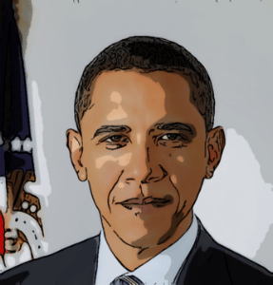
He is the president of the United States.

Slide 7
She is famous and rich.

Slide 8
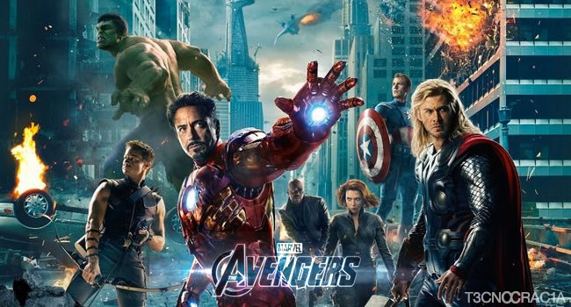
It is a wonderful film.

Slide 9
We are at home.

Slide 10
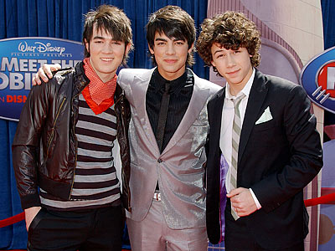
They are brothers.

Slide 11
Affirmative Sentences
I am from Brazil.
You are a student.
He is intelligent.
She is Japanese.
It is difficult.
We are Brazilian.
You are students.
They are from England.

Slide 12
Affirmative Form and Contracted Form
I am / I’m
You are / You’re
He is / He’s
She is / She’s
It is / It’s
We are / We’re
You are / You’re
They are / They’re

Slide 13
Affirmative Sentences – Contracted Forms
I’m from Brazil.
You’re a student.
He’s intelligent.
She’s Japanese.
It’s difficult.
We’re Brazilian.
You’re students.
They’re from England.

Slide 14
Negative Form
I am not
You are not
He is not
She is not
It is not
We are not
You are not
They are not

Slide 15
Negative Sentences
I am not from Argentina.
You are not a student.
He is not Canadian.
She is not Spanish.
It is not beautiful.
We are not friends.
You are not from this class.
They are not my brothers.

Slide 16
Negative Form and Contracted Forms
I am not /I’m not
You are not /You’re not / You aren’t
He is not /He’s not / He isn’t
She is not /She’s not / She isn’t
It is not /It’s not / It isn’t
We are not / We’re not / We aren’t
You are not /You’re not / You aren’t
They are not /They’re not / They aren’t

Slide 17
Interrogative Form
Am I?
Are you?
Is he?
Is she?
Is it?
Are we?
Are you?
Are they?
To make questions in English it is necessary to use the inversion of the subject pronoun and the verb to be.
YOU
ARE
?

Slide 18
Am I right?
No, you are not./
No, you aren’t
Yes, you are.

Slide 19
Are you American?
No, I’m not.
Yes, I am.

Slide 20
Is he married?
No, he is not.
No, he isn’t.
Yes, he is.

Slide 21
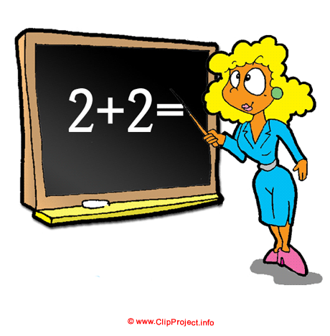
Is she a teacher?
No, she is not./
No, she isn’t.
Yes, she is.

Slide 22
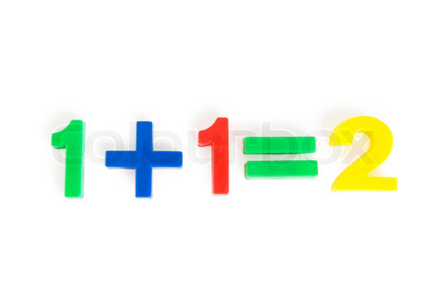
Is it difficult?
Yes, it is.
No, it is not./
No, it isn’t.

Slide 23
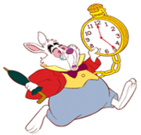
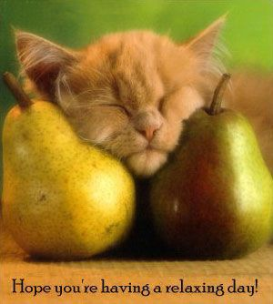
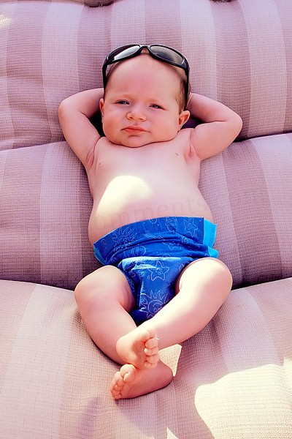
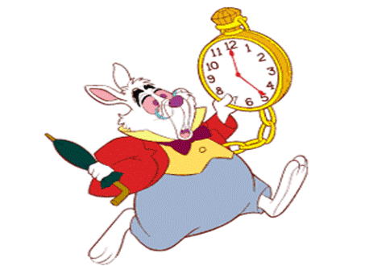
Are we late?
No, we are not./
No, we aren’t.
Yes, we are.

Slide 24
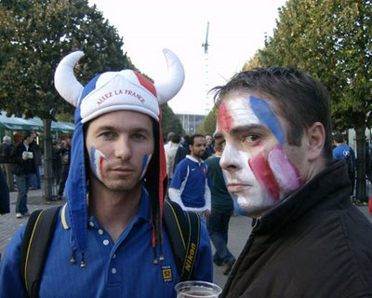
Are you from Brazil?
No, we are not./
No, we aren’t.
Yes, we are.

Slide 25
Are they friends?
No, they are not./
No, they aren’t.
Yes, they are.

Slide 26
The End Thanks for watching!
Adriana Pires

